Slide 1

BACHELOR OF TECHNOLOGY
IN
Artificial Intelligence and Machine Learning
Project Title : Translating The Language Of Hands Using Sign Language Interpretation Tool
Section : ZETA
Batch Number: ZT-06
Roll Numbers :
Project Guide : P.Hemalatha
Department of AIML, School of Engineering
Malla Reddy University

Slide 2
CONTENTS
INTRODUCTION:
Project Identification / Problem Definition
Objective of project
Scope of the project
ANALYSIS:
Project Planning and Research
Software requirement specification
Software requirement
Hardware requirement
Model Selection and Architecture
DESIGN:
Introduction
DFD/ER/UML diagram(any other project diagram)
Data Set Descriptions
Data Preprocessing Techniques
Methods & Algorithms
DEPLOYMENT AND RESULTS:
Introduction
Source Code
Model Implementation and Training
Model Evaluation Metrics
Model Deployment
Web GUI’s Development & Integration
Results : Testing , Validation & Final Results
CONCLUSION:
Project Conclusion
Future Scope

Slide 3
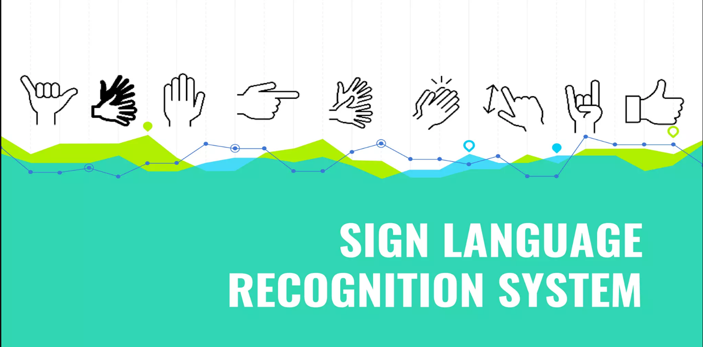

Slide 4
INTRODUCTION
PROBLEM DEFINITION:
The problem addressed by this project is The communication barrier between sign language users and the hearing world is a major obstacle to equal access and opportunity. Current solutions are often inadequate, ill-suited for natural interaction, and fail to capture the richness of real-time conversation. This necessitates the development of innovative technology to bridge the gap, fostering seamless and natural communication between these two communities. By overcoming this barrier, we can unlock a world of inclusivity and understanding for all.
OBJECTIVE OF PROJECT:
The primary objective of this project is to develop a Sign Language Detection (SLD) system capable of translating sign language gestures into spoken or written language in real-time. By leveraging advanced machine learning algorithms and interpretation tools, the project aims to bridge the communication gap between sign language users and non-signers. The goal is to create a user-friendly system that can be integrated into various devices, providing an accessible solution for daily communication needs.
Another key objective is to enhance the accuracy and speed of sign language recognition. The project seeks to develop algorithms that can precisely interpret the complex and nuanced gestures of sign language, ensuring that the translations are reliable and contextually appropriate. This involves continuous research and development to improve the system's performance, making it adaptable to different sign languages and dialects used around the world.

Slide 5
SCOPE OF PROJECT:
The scope of the project includes the development of a comprehensive model that utilizes a pipeline to capture input through a web camera from users signing gestures. The system processes the video input by extracting frames and generating possible interpretations of each gesture. This involves sophisticated image processing techniques and the application of machine learning models trained on extensive datasets of sign language gestures.
In addition to the core functionality of gesture recognition and translation, the project aims to address the inherent complexity of sign language. Various approaches to operationalizing sign language based on linguistic and physical data are reviewed to ensure high-fidelity modeling. This includes capturing linguistically relevant features of the sign language signal, which is crucial for accurate and meaningful translations.
Future enhancements aim to expand the model's capabilities to encompass a broader range of sign languages, including regional variations and dialects. Additionally, the system will be refined to detect facial expressions and body language, which are integral to conveying nuanced meaning in sign language conversations. This will further enhance the model's ability to accurately interpret and translate sign language, making it an even more effective communication tool.
Integrating this enhanced sign language detection system into real-world applications can have a profound impact on the lives of deaf and hard-of-hearing individuals. By enabling real-time sign language translation, the technology can bridge communication gaps and foster inclusivity in various domains, such as education, healthcare, and the workplace. The development of accessible educational platforms and communication tools can empower deaf and hard-of-hearing individuals to fully participate in society, opening doors to new opportunities and enriching their lives.

Slide 6
ANALYSIS
PROJECT PLANNING:
Partner with sign language experts and native signers to create a diverse dataset of sign language gestures. Record high-quality videos showcasing signers with variations in lighting and background. Annotate videos with precise sign labels, ensuring accuracy and consistency.
Construct a deep learning model, such as a convolutional neural network (CNN), to detect spatial and temporal patterns in sign language videos. Train the model on the prepared dataset, utilizing techniques like data augmentation to enhance performance. Rigorously evaluate model accuracy and fine-tune its architecture for optimal results.
Deploy the trained model for real-time sign language detection, integrating it with user-friendly interfaces. Gather user feedback and real-world data to continuously improve model accuracy and adaptability. Explore diverse applications of the technology, from communication tools to educational resources for the deaf and hard-of-hearing community.
Continuously monitor the system's performance, collect user feedback, and adapt the model to address any challenges or biases that may arise. Strive to create a truly inclusive and effective communication tool for the deaf and hard-of-hearing community.

Slide 7
SOFTWARE REQUIREMENT SPECIFICATION
SOFTWARE REQUIREMENTS:
i. Machine Learning Frameworks and Libraries:
TensorFlow: TensorFlow was employed as the main machine learning framework for building and training the sign language detection models. Its flexibility and support for deep learning made it suitable for handling the complex computations required for gesture recognition.
Keras: Keras, a high-level neural networks API running on top of TensorFlow, was used for its user-friendly interface and ease of model prototyping. It allowed us to quickly build and experiment with different neural network architectures.
ii. Additional Libraries and Modules:
cvzone==1.6.1: Used for hand detection and gesture classification. It provided convenient modules for tracking hands and classifying gestures.
matplotlib==3.8.4: Used for visualizations and plotting graphs.
mediapipe==0.10.9: Utilized for hand tracking and gesture recognition.
numpy==1.26.4: Used for numerical computations and handling large arrays and matrices.
opencv-contrib-python==4.9.0.80: Used for advanced image and video processing tasks.
opencv-python==4.9.0.80: Employed for basic image and video processing.
pillow==10.3.0: Used for image manipulation and processing.
scipy==1.13.0: Used for scientific computations and technical computing.
iii. Data Set:
The Data Set we used for SLD is American Sign language Detection Dataset

Slide 8
HARDWARE REQUIREMENTS:
Computational Hardware:
High-Performance Computer: A high-performance computer was essential for developing and training the machine learning models. The system required a multi-core processor (Intel i7 or higher) and a minimum of 16GB RAM to handle intensive computations and large datasets efficiently.
GPU (Graphics Processing Unit): For training deep learning models, a dedicated GPU was used to accelerate the training process. NVIDIA GPUs with CUDA support (e.g., NVIDIA GeForce GTX 1080 or higher) were preferred for their ability to process parallel computations, significantly reducing training times.
Input Devices:
Web Camera: A high-resolution web camera was necessary for capturing video input of the user’s hand gestures. The camera needed to support at least 720p resolution to ensure clear and precise image capture, which is crucial for accurate gesture recognition.
Networking:
Internet Connection: A reliable high-speed internet connection was necessary for downloading libraries, frameworks, and datasets. It also facilitated collaboration among team members through online platforms and tools.
Microphone and Speakers: For systems involving voice synthesis or feedback, a quality microphone and speakers were required to ensure clear audio input and output.

Slide 9
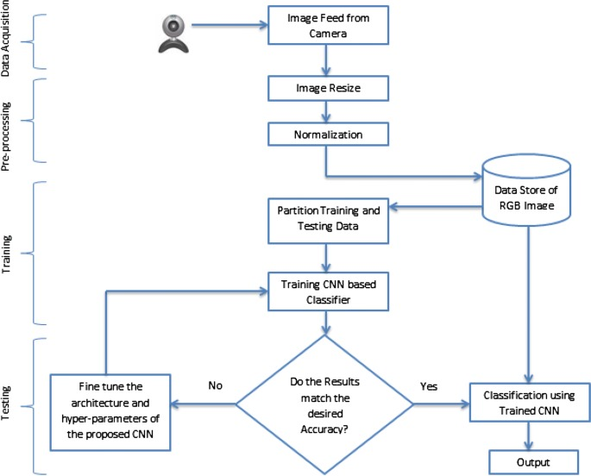
MODEL SELECTION AND ARCHITECTURE:

Slide 10
DESIGN
Introduction
The design phase of the Sign Language Detection (SLD) project involved a systematic approach to developing a robust system capable of recognizing and translating sign language gestures into spoken language. This phase encompassed several critical components, including the selection of appropriate datasets, data preprocessing techniques, and the implementation of machine learning methods and algorithms. Our objective was to create an efficient and accurate model that facilitates seamless communication between deaf individuals and non-sign language speakers
Methods & Algorithms
1. Hand Detection and Tracking:
MediaPipe: Used for real-time hand detection and tracking. It provided robust hand landmark detection, which was essential for accurately identifying hand positions and movements.
cvzone: Utilized for integrating hand detection and classification modules, facilitating the seamless flow of data between detection and recognition stages.
2. Gesture Classification:
Convolutional Neural Networks (CNNs): Implemented CNNs to recognize and classify static hand gestures. The architecture consisted of multiple convolutional and pooling layers, followed by fully connected layers for final classification.
Transfer Learning: Leveraged pre-trained models such as MobileNet and VGG16 for feature extraction, fine-tuning them on our sign language datasets to improve performance and reduce training time.
3. Integration and Deployment:
TensorFlow Serving: Deployed the trained models using TensorFlow Serving, enabling efficient inference and scalability of the SLD system.

Slide 11
DEPLOYMENT AND RESULT
SOURCE CODE:
import cv2
from cvzone.HandTrackingModule import HandDetector
from cvzone.ClassificationModule import Classifier
import numpy as np
import math
cap = cv2.VideoCapture(0)
detector = HandDetector(maxHands=2)
classifier = Classifier("Model/keras_model.h5" , "Model/labels.txt")
offset = 20
imgSize = 300
counter = 0
labels = ["Hello", "I love you", "No", "Okay", "Please", "Thank you", "Yes"]
while True:
success, img = cap.read()
imgOutput = img.copy()
hands, img = detector.findHands(img)
if hands:
hand = hands[0]
x, y, w, h = hand['bbox']
imgCrop = img[y-offset:y + h + offset, x-offset:x + w + offset]
# Check if imgCrop has a valid size
if not imgCrop.size == 0:
imgWhite = np.ones((imgSize, imgSize, 3), np.uint8)*255
imgCropShape = imgCrop.shape

Slide 12
spectRatio = h / w
if aspectRatio > 1:
k = imgSize / h
wCal = math.ceil(k * w)
imgResize = cv2.resize(imgCrop, (wCal, imgSize))
imgResizeShape = imgResize.shape
wGap = math.ceil((imgSize-wCal)/2)
imgWhite[:, wGap: wCal + wGap] = imgResize
prediction , index = classifier.getPrediction(imgWhite, draw= False)
print(prediction, index)
else:
k = imgSize / w
hCal = math.ceil(k * h)
imgResize = cv2.resize(imgCrop, (imgSize, hCal))
imgResizeShape = imgResize.shape
hGap = math.ceil((imgSize - hCal) / 2)
imgWhite[hGap: hCal + hGap, :] = imgResize
prediction , index = classifier.getPrediction(imgWhite, draw= False) cv2.rectangle(imgOutput,(x-offset,y-offset-70),(x -offset+400, y - offset+60-50),(0,255,0),cv2.FILLED)
cv2.putText(imgOutput,labels[index],(x,y-30),cv2.FONT_HERSHEY_COMPLEX,2,(0,0,0),2)
cv2.rectangle(imgOutput,(x-offset,y-offset),(x + w + offset, y+h + offset),(0,255,0),4) cv2.imshow('ImageCrop', imgCrop)
cv2.imshow('ImageWhite', imgWhite)
else:
print("imgCrop has an invalid size. Skipping...")
cv2.imshow('Image', imgOutput)
if cv2.waitKey(1) & 0xFF == ord('q'):
break
cap.release()
cv2.destroyAllWindows()

Slide 13
Model Implementation & Training
Convolutional Neural Networks (CNNs):
Base Model: CNNs were chosen for their proven ability to recognize spatial patterns in images, making them ideal for gesture detection.
2. Data Preparation:
Dataset Splitting: 70% training, 15% validation, 15% testing.
Data Augmentation: Techniques like rotation, scaling, and flipping were applied to enhance model generalization.
3. Training Process:
Loss Function: Categorical cross-entropy (suitable for multi-class classification).
Optimizer: Adam optimizer (efficient, adaptive learning rate).
Batch Size and Epochs: Batch size of 32, up to 50 epochs with early stopping to prevent overfitting.
4. Training Pipeline:
Input: Real-time video from web camera.
Preprocessing: Resizing, normalization, grayscale conversion.
CNN-LSTM Model: CNN extracts features, LSTM models temporal dynamics of gestures.

Slide 14
Model Evaluation, Testing & Validation
1. Evaluation Metrics:
Accuracy: Percentage of correctly classified gestures.
Precision, Recall, F1-Score: Detailed performance insights, especially for imbalanced datasets.
Confusion Matrix: Visualization of model's predictions, true positives/negatives, false positives/negatives.
2. Validation and Testing:
Cross-Validation: K-fold method to assess robustness across different data subsets.
Model Training: Trains the model on the training set.
Testing: Tests the final model on the test set to evaluate its performance
Test Set Evaluation: Final model evaluated on unseen data to gauge accuracy and generalization.
3. Model Optimization:
Hyperparameter Tuning: Adjusted learning rate, batch size, etc., for optimal performance.
Regularization Techniques: Dropout and batch normalization used to prevent overfitting.

Slide 15
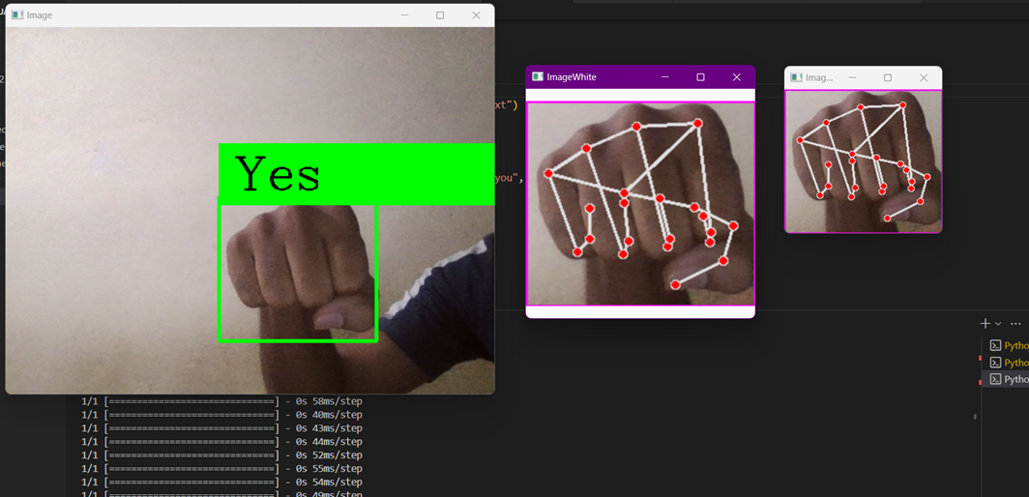
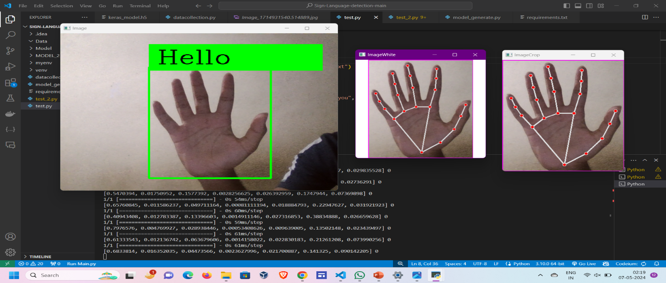

Slide 16
PROJECT CONCLUSION:
Project Achievements:. Throughout the duration of our Sign Language Detection (SLD) project, significant milestones have been accomplished. We successfully developed a robust system capable of accurately recognizing and interpreting sign language gestures. This achievement involved extensive research into computer vision algorithms and machine learning models tailored to the complexities of sign language recognition. By leveraging these technologies, we've been able to create a reliable tool that bridges communication gaps between hearing-impaired individuals and the broader community
Challenges Overcome: Overcoming challenges was a pivotal aspect of our project journey. Initially, we faced hurdles related to dataset diversity and model accuracy. Through iterative testing and refinement, we enhanced our algorithms to achieve higher recognition rates across various sign languages and individual signing styles. Additionally, integrating real-time processing capabilities posed technical obstacles which were surmounted through collaborative problem-solving and innovative engineering solutions.
Impact and Benefits: The impact of our SLD project extends beyond technical achievements to meaningful improvements in accessibility and inclusivity. By enabling real-time interpretation of sign language gestures, our system empowers hearing-impaired individuals to communicate effectively in diverse settings, whether educational, professional, or social. This capability not only enhances their quality of life but also fosters a more inclusive society where communication barriers are minimized.

Slide 17
